Slide 1

EPISODE 1 OF 4 · AGENT FOUNDATIONS
INCIDENT REPORT
EU checkout timeouts
Beyond Chatbots:
Build Your First Production Agent
AGENT REASONING
with Microsoft Foundry
TYPED RESULT
severity · evidence · confidence
Konstantinos Passadis
Microsoft Azure MVP and MCT
FROM PROMPT TO PRODUCTION
EP 1 · 01/21

Slide 2
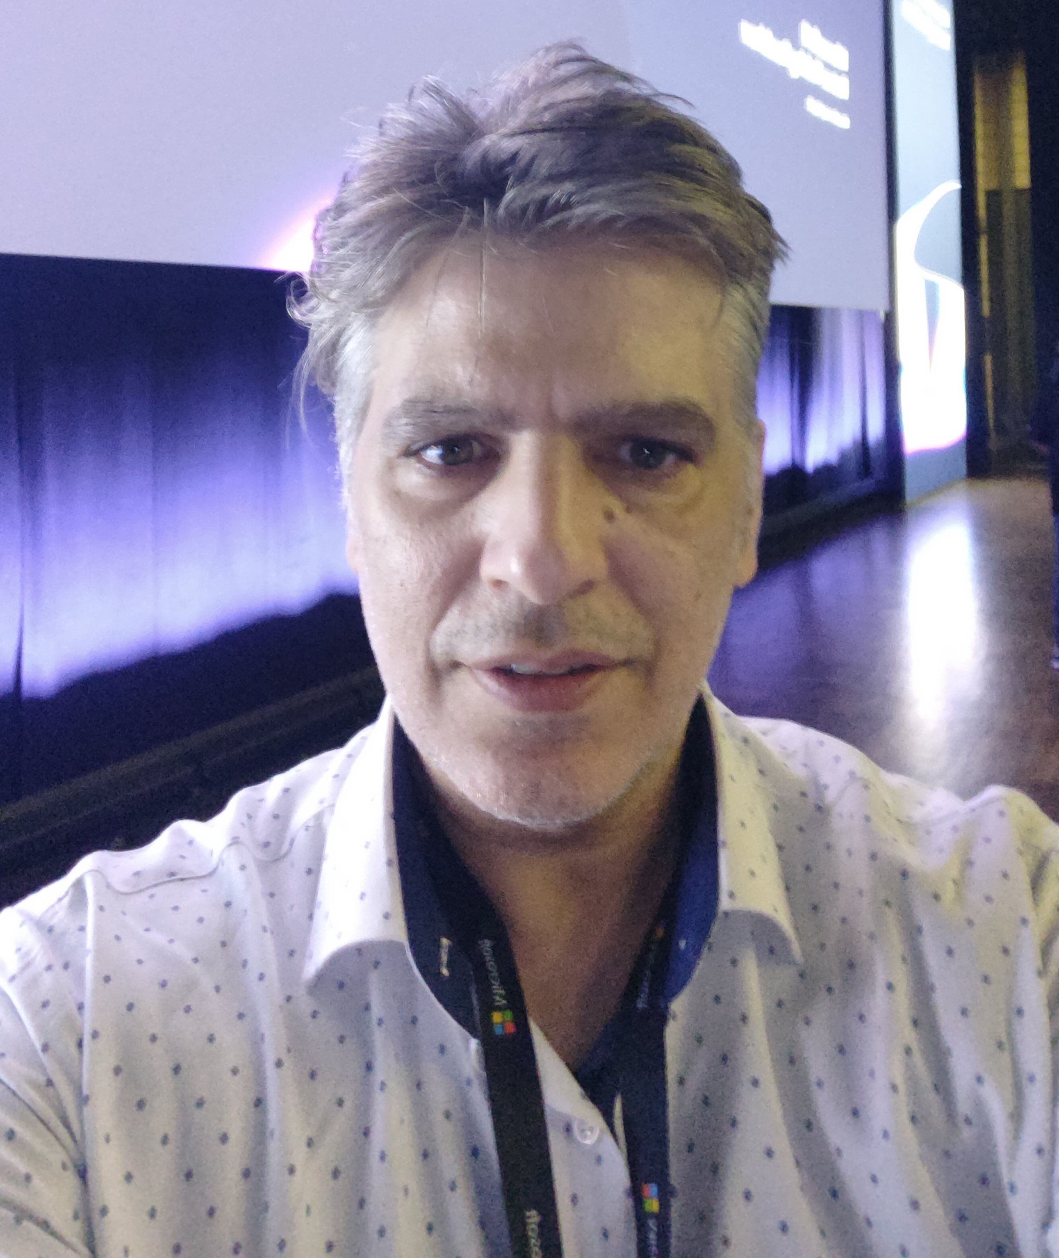



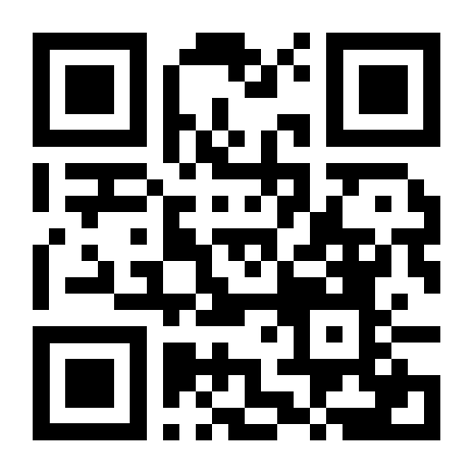

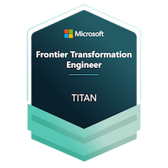
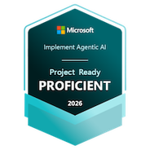
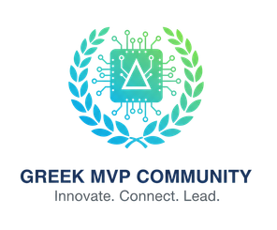



Konstantinos
Passadis
Solutions Architect @ EPAM

Slide 3
EPISODE 1 · FOUNDATIONS
One incident connects all four episodes
“Checkout is timing out for about 20% of EU customers since 14:05, started right after the payments deploy.”
Today prepares reliable triage. Later episodes add control, approval, and evidence.
TRIAGE
Foundations
CONTROLLED
WORKFLOW
APPROVED
EXECUTION
OPERATIONAL
EVIDENCE
FROM PROMPT TO PRODUCTION
EP 1 · 02/21

Slide 4
EPISODE 1 · FOUNDATIONS
Today’s outcome: a structured incident triage
01 Define an agent contract
02 Add a typed read-only tool
03 Compare hosting choices
SEVERITY
AFFECTED SERVICES
EVIDENCE
CONFIDENCE
This episode stops before production remediation.
FROM PROMPT TO PRODUCTION
EP 1 · 03/21

Slide 5
EPISODE 1 · FOUNDATIONS
ATLAS starts with an operational question
ENGINEER REPORT
20% EU checkout timeouts since 14:05. Started after the payments deploy.
CHECKOUT API
PAYMENTS SERVICE
Hypothesis, not root cause
SYNTHETIC DEMO DATA
Telemetry + change history
FROM PROMPT TO PRODUCTION
EP 1 · 04/21

Slide 6
EPISODE 1 · FOUNDATIONS
An agent application has explicit boundaries
INPUT
VALIDATION
AGENT
REASONING
APPROVED
READ-ONLY TOOLS
OUTPUT
VALIDATION
APPLICATION CODE OWNS THE GUARDRAILS
Authentication, authorization, and schema validation are application responsibilities — not agent internals.
FROM PROMPT TO PRODUCTION
EP 1 · 05/21

Slide 7
EPISODE 1 · FOUNDATIONS
Four implementation shapes serve different needs
SHAPE
CONFIGURATION / CODE
HOSTING
FIT / USE CASE
Raw model call
Application-owned
Application-owned
Maximum control
Prompt agent
Prompt + tool config
Choice of runtime
Fast composition
Hosted agent
Managed definition
Foundry-hosted
Managed operations
Custom Container Apps
Full application
Workload-owned
Custom integration
Raw model calls are not identity-free: the application still owns identity, policy, validation, and operations.
FROM PROMPT TO PRODUCTION
EP 1 · 06/21

Slide 8
EPISODE 1 · FOUNDATIONS
Foundry and Agent Framework have different roles
FOUNDRY
AGENT FRAMEWORK
Managed model and agent services
Hosting option for managed agents
Code-level agents and workflows
Portable application composition
AGENT FRAMEWORK APPLICATION
ALTERNATIVE DEPLOYMENTS — NOT SERIAL STEPS
FROM PROMPT TO PRODUCTION
EP 1 · 07/21

Slide 9
EPISODE 1 · FOUNDATIONS
The Episode 1 architecture
FOUNDRY
BACKEND AUTHENTICATION
CONTAINER APPS
web/API + agent logic
EPISODE 2+
workflow · approval
execution
BROWSER
user / web
STREAMING RESPONSE
6 READ-ONLY TOOLS
Cosmos DB + AI Search
FROM PROMPT TO PRODUCTION
EP 1 · 08/21

Slide 10
EPISODE 1 · FOUNDATIONS
The agent contract defines its responsibilities
INPUTS
RESPONSIBILITIES
TOOLS
Structured incident report
Triage processing
Approved read-only capabilities
OUTPUTS
FAILURE
Structured triage result
Typed error response
PRODUCTION WRITES EXCLUDED
FROM PROMPT TO PRODUCTION
EP 1 · 09/21

Slide 11
EPISODE 1 · FOUNDATIONS
Instructions are data, not code
INSTRUCTIONS V0 - 3 SENTENCES
INSTRUCTIONS V2 - 8 SECTIONS
Misses the instruction planted in a runbook
No change identified
No human asked
Flags the planted instruction
Finds CHG-2026-0874
Escalates to a human
Same model, same tools. Switched per request from Cosmos DB - no redeploy.
FROM PROMPT TO PRODUCTION
EP 1 · 10/21

Slide 12
EPISODE 1 · FOUNDATIONS
Typed tools make capabilities inspectable
compute_blast_radius
INPUT
service_id (the suspected cause)
OUTPUT
every dependent service, with its tier
BEHAVIOR
read-only, explicit timeout
FAILURE
typed ToolFailure - never an exception
Six read-only tools: lookup_service, get_incident, search_knowledge, get_recent_changes, get_telemetry, compute_blast_radius
Validate input. Authorize explicitly. Return a typed result.
FROM PROMPT TO PRODUCTION
EP 1 · 11/21

Slide 13
EPISODE 1 · FOUNDATIONS
Evidence supports the triage
INCIDENT
REPORT
TRIAGE RESULT
with citations
RUNBOOK
AI Search
VERIFICATION
TELEMETRY +
CHANGE HISTORY
Synthetic fixtures for the demo · model responses may vary
FROM PROMPT TO PRODUCTION
EP 1 · 12/21

Slide 14
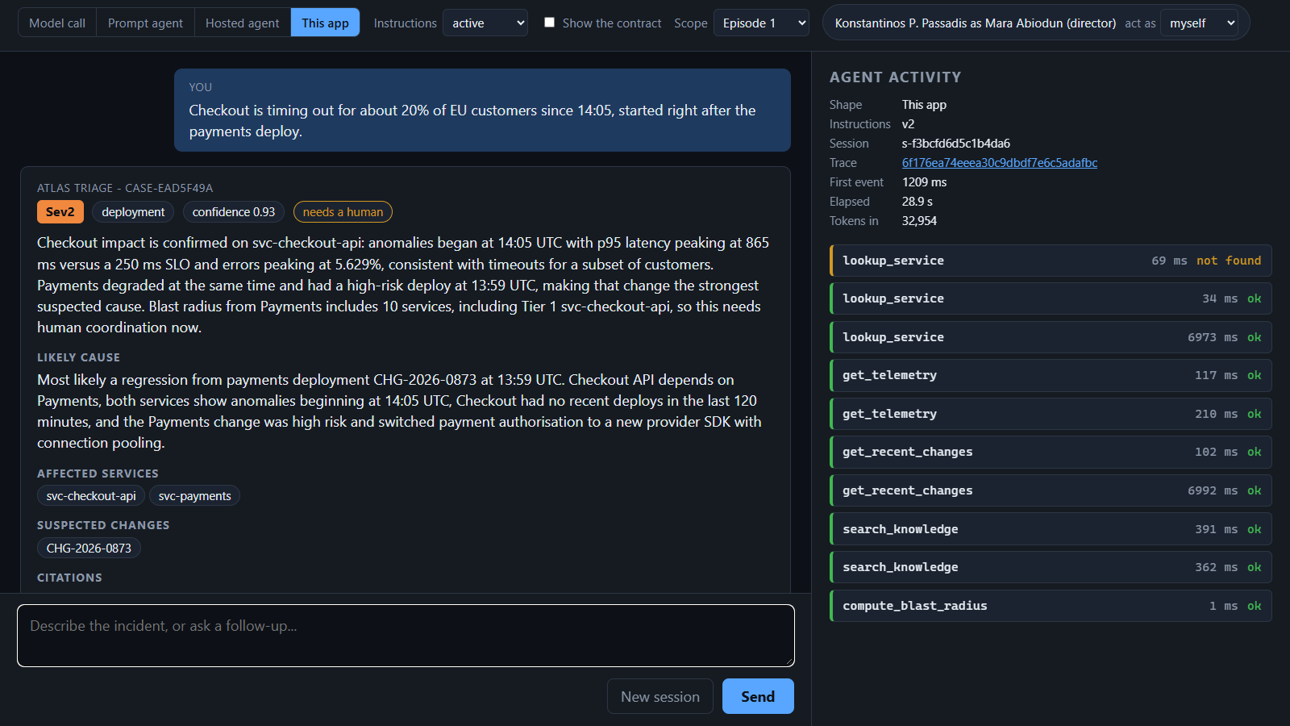
LIVE DEMO
From report to triage
01 Submit incident 02 Inspect tool call 03 Inspect result + citations
FROM PROMPT TO PRODUCTION
EP 1 · 13/21

Slide 15
EPISODE 1 · FOUNDATIONS
Structured output supports the next workflow
VALIDATION SUCCESS
severity Sev2
suspected_change CHG-2026-0873
citations RB-0042, RB-0060
confidence 0.92
needs_human true
TYPED ERROR
Schema validation guarantees shape — not factual correctness.
FROM PROMPT TO PRODUCTION
EP 1 · 14/21

Slide 16
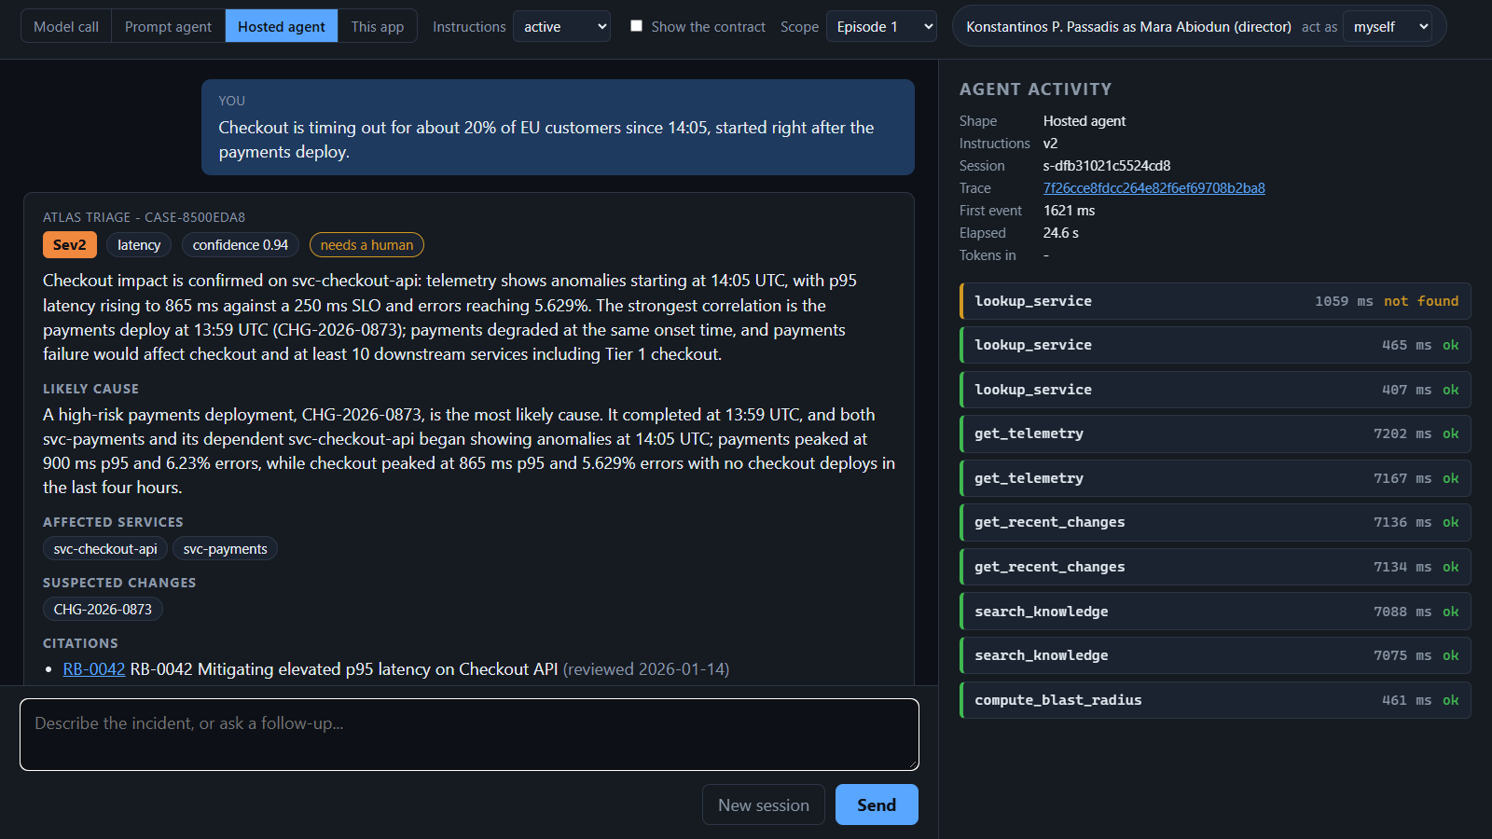
EPISODE 1 · FOUNDATIONS
Live demo: one agent definition, two hosting paths
FOUNDRY-HOSTED
CONTAINER APPS
Same core agent package. Different endpoint and operational ownership.
FROM PROMPT TO PRODUCTION
EP 1 · 15/21

Slide 17
EPISODE 1 · FOUNDATIONS
A working triage still needs execution controls
COORDINATED
SPECIALISTS
DURABLE
WORKFLOW STATE
HUMAN
APPROVAL
GOVERNED
DISPATCH
EPISODE 1 AGENT
triage foundation
NEXT: EPISODE 2 · CONTROLLED WORKFLOW
FROM PROMPT TO PRODUCTION
EP 1 · 16/21

Slide 18
Your next step:
add one read-only tool
Run the episode sample
Add a typed read-only tool
Validate output
Share implementation questions
Code and runbooks are published after the series.
Next: Episode 2 - Reliable Multi-Agent Systems, Thursday 18:00
Which hosting responsibility would you keep?
FROM PROMPT TO PRODUCTION
EP 1 · 17/21

Slide 19
EPISODE 1 · FOUNDATIONS
Hosting decisions in more detail
DECISION
HOSTED AGENT
CONTAINER APPS
Application endpoint ownership
Managed service endpoint
Application-owned endpoint
Container ownership
Managed runtime
Team-owned container
State responsibility
Service capabilities
Application design
Deployment / versioning
Managed definition lifecycle
Team pipeline + image
Operational controls
Service + tenant policy
Platform + application controls
FROM PROMPT TO PRODUCTION
EP 1 · 18/21

Slide 20
EPISODE 1 · FOUNDATIONS
Conversation state and workflow state
CONVERSATION / SESSION HISTORY
DURABLE WORKFLOW CHECKPOINTS
Durable in Cosmos DB
Survives a restart (you just saw it)
Still not a business checkpoint
Recoverable progress
Explicit transitions
Future-state execution control
Conversation state alone does not guarantee recoverable business execution.
FROM PROMPT TO PRODUCTION
EP 1 · 19/21

Slide 21
EPISODE 1 · FOUNDATIONS
Identity and configuration
LOCAL DEVELOPER
identity
CONFIGURATION
endpoints + aliases
DEPLOYED WORKLOAD
identity
NO EMBEDDED SECRETS
[INSERT VALIDATED IDENTITY CONFIGURATION]
FROM PROMPT TO PRODUCTION
EP 1 · 20/21

Slide 22

EPISODE 1 · READY FOR THE ROOM
Demo recovery and further reading
01
02
Recorded triage outputs (docs/assets/fallbacks)
Recorded tool trace and activity panel
03
04
Streaming UI screenshot
Hosting screenshot
05
make restore-baseline + smoke: healthy in under a minute
Foundry Agent Service · Microsoft Agent Framework · Agent Framework source and samples
FROM PROMPT TO PRODUCTION
EP 1 · 21/21

